Slide 1

VIOLENT CRIME AND ECONOMIC DEVELOPMENT IN CENTRAL AMERICA
Key trends from 2018 to 2023, with an emphasis on El Salvador
Andy Fan, Will Sigal, Juan Ulloa

Slide 2


DATA
Armed Conflict Location & Event Data
An independent, impartial, international non-profit organization collecting data on violent conflict and protest in all countries and territories in the world.
World Bank Development Indicators
Collection of development indicators, compiled from officially-recognized international sources. Time series data as far back as 1960.
Notes:
dshdshousdhoi

Slide 3
AGENDA
Violent Crime in El Salvador
Analyze raw trends of crime in El Salvador and Latin America overtime
Take a deeper look into the possible events that created discontinuity in incidence rates
Consider disaggregated data to better understand the decrease in-terms of “actors” and “events”
View Shiny App for geospatial analysis of the decrease in crime
Relationship Between Violent Crime and Economic Development
Consider relation between student enrollment and violent crime
Analyze relation between per-capita GDP and violent crime
Notes:
dshdshousdhoi

Slide 4
Violent Crime in El Salvador

Slide 5
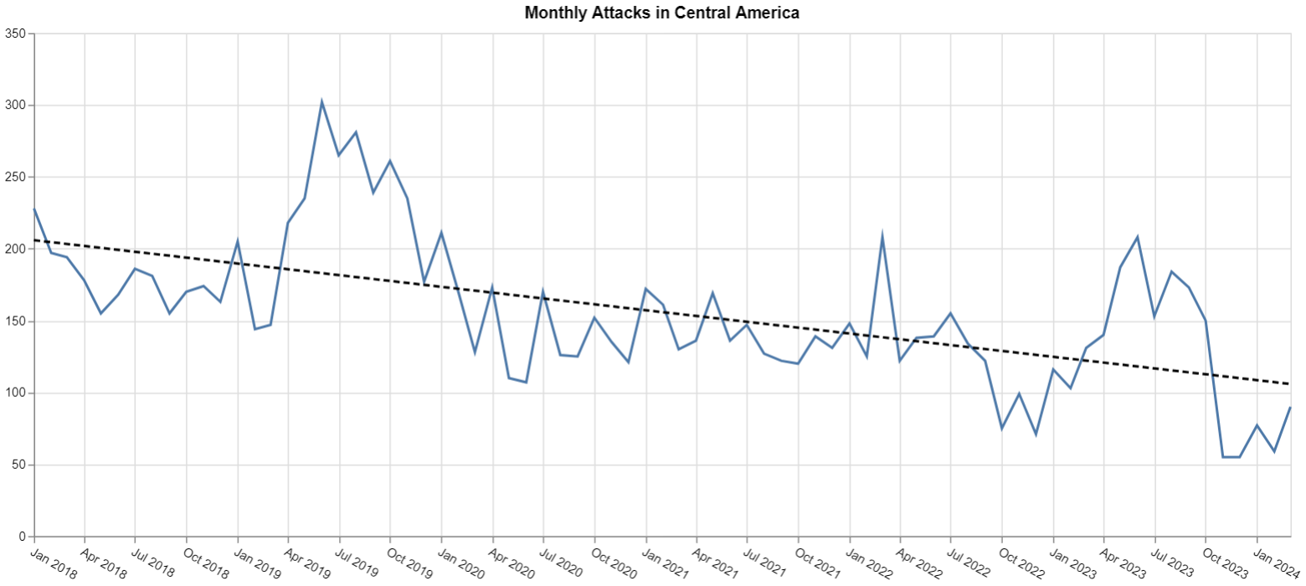
On average, monthly attacks have drastically decreased in Central America from January 2018 to March 2024

Slide 6
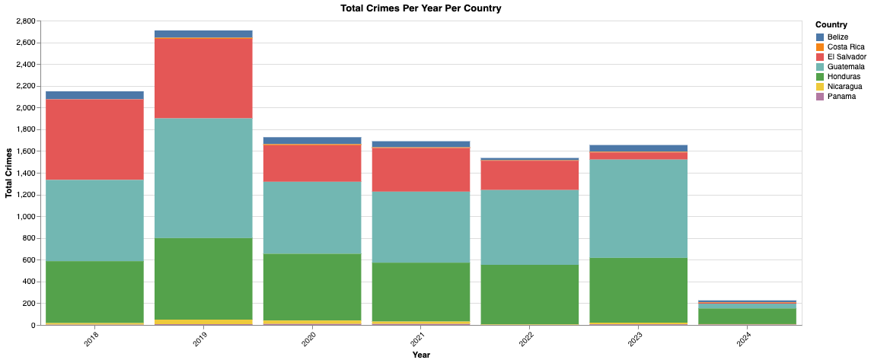
While violent crime trends are similar across most countries, Central America’s general decrease in crime is largely driven by El Salvador

Slide 7
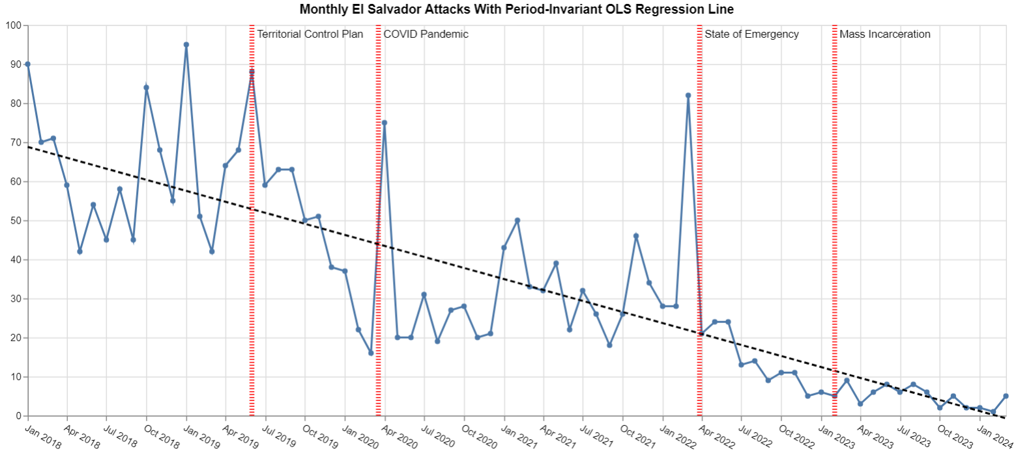
In the last six years, El Salvador has dramatically decreased monthly attacks from a peak of 95 in Jan 2019 to a low of 1 in Feb 2024

Slide 8
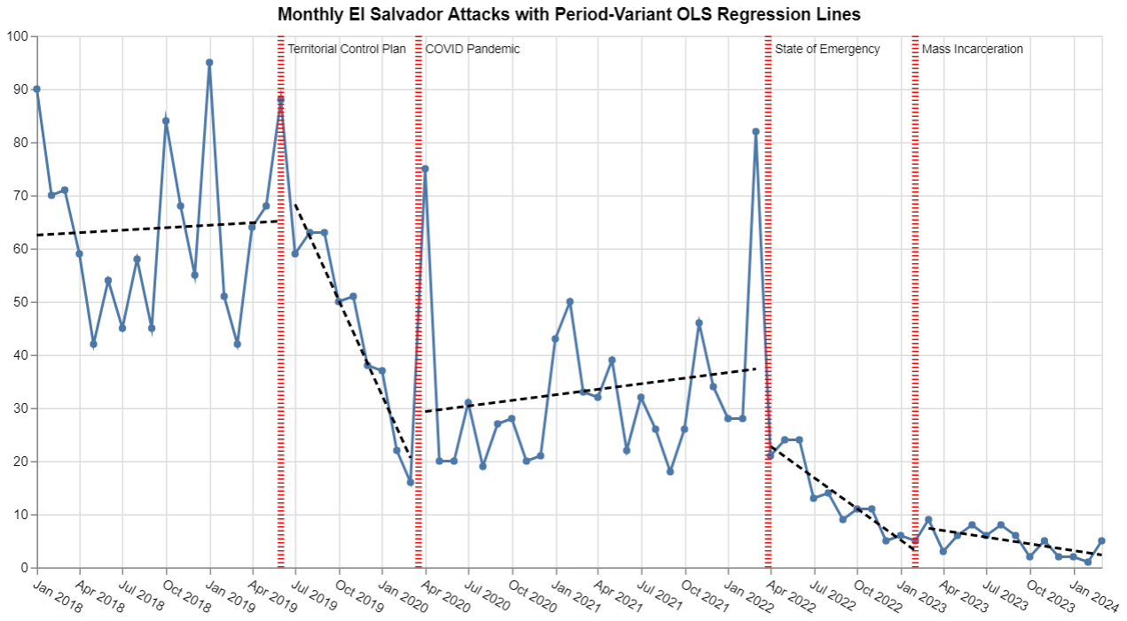
El Salvador’s decrease in crime comes from four major shocks, including gang violence policies and the COVID pandemic

Slide 9
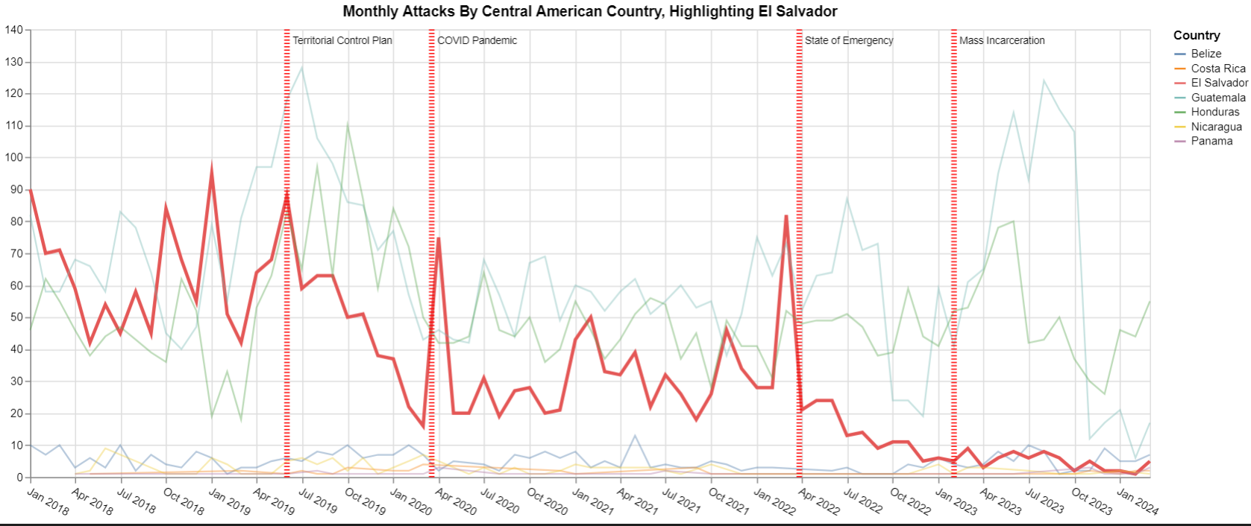
While many countries faced similar changes in crime, El Salvador’s gang violence reduction policies sharply diminished attacks

Slide 10
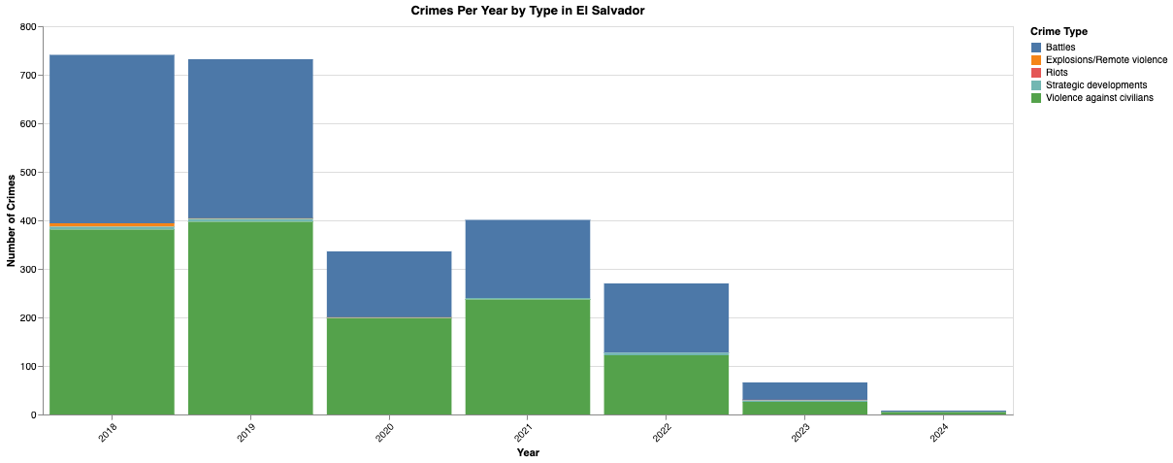
El Salvador’s crime reduction is accelerated by decreases in violence against civilians and battles by armed, organized groups

Slide 11
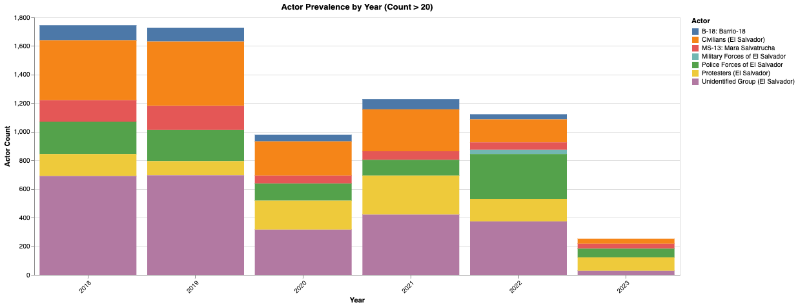
Major gang and unidentified group attacks have continuously fallen while protester involvement has sharply increased

Slide 12
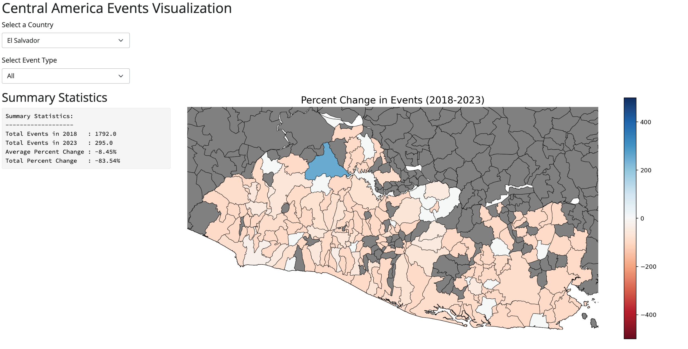
El Salvador reduced violent crime across the entire country, but increased crime in rural areas near the Guatemala-Honduras border

Slide 13
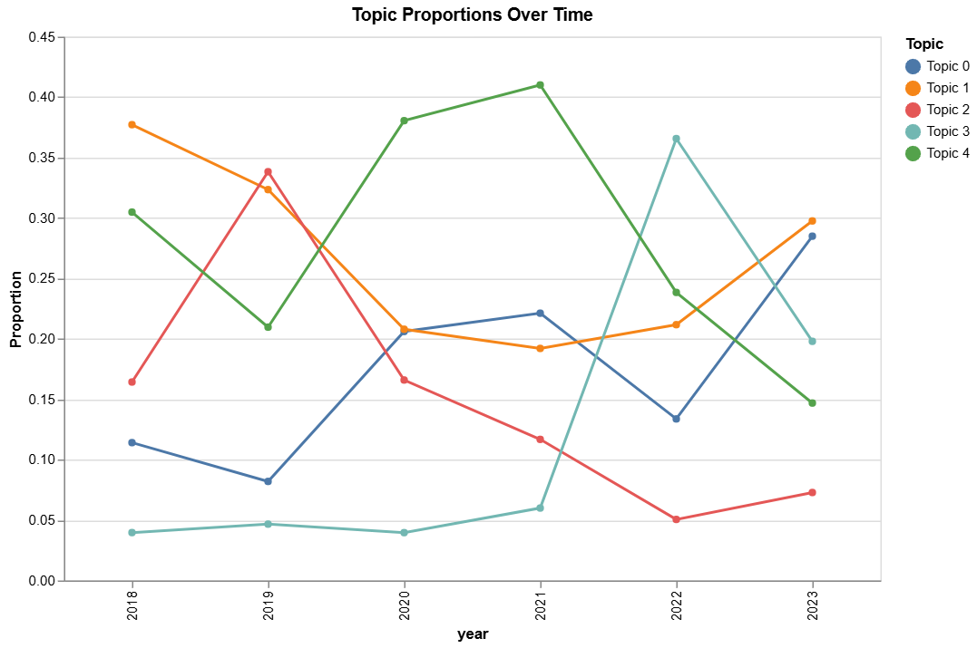
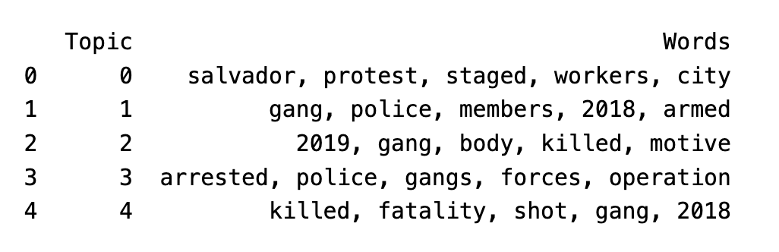
Descriptions associated with deaths and violence have decreased while descriptions of protests and police members has increased

Slide 14
Violent Crime and Economic Development Indicators

Slide 15
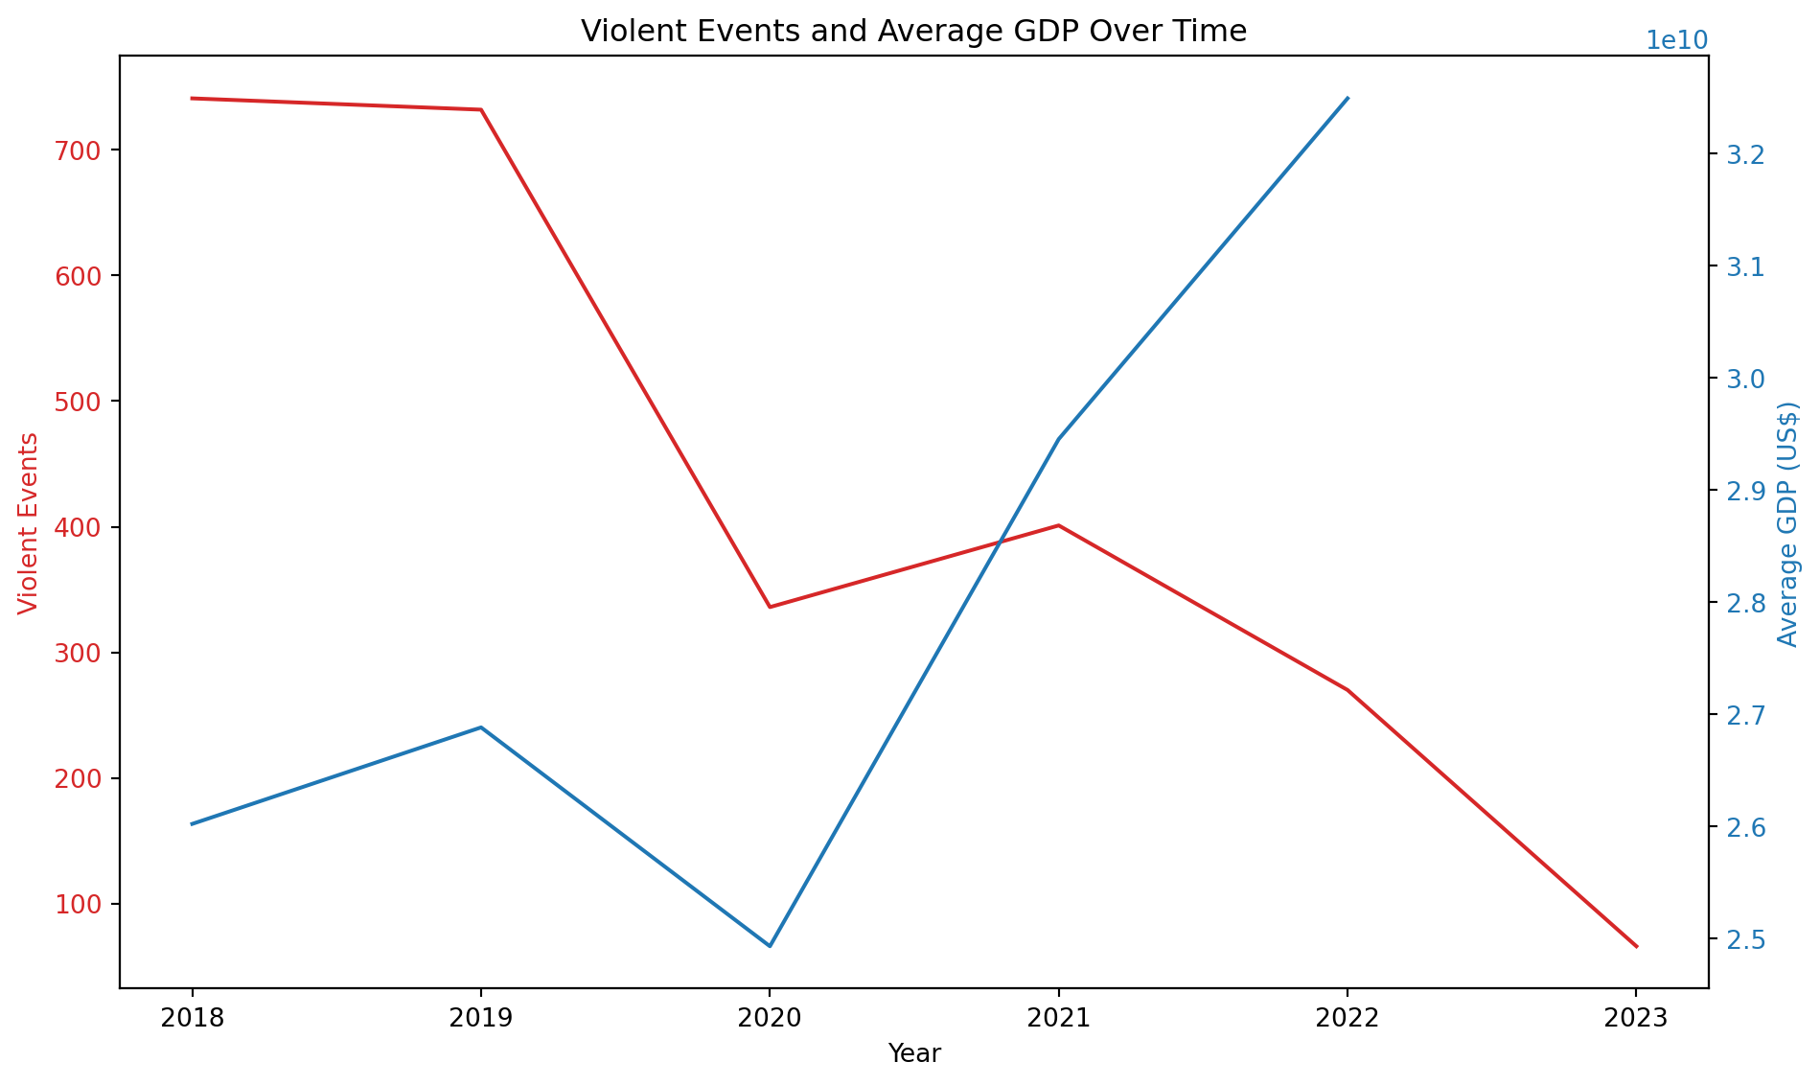
Since 2020, Central American countries experiencing decreases in violent crime tend to benefit from increases in average GDP

Slide 16
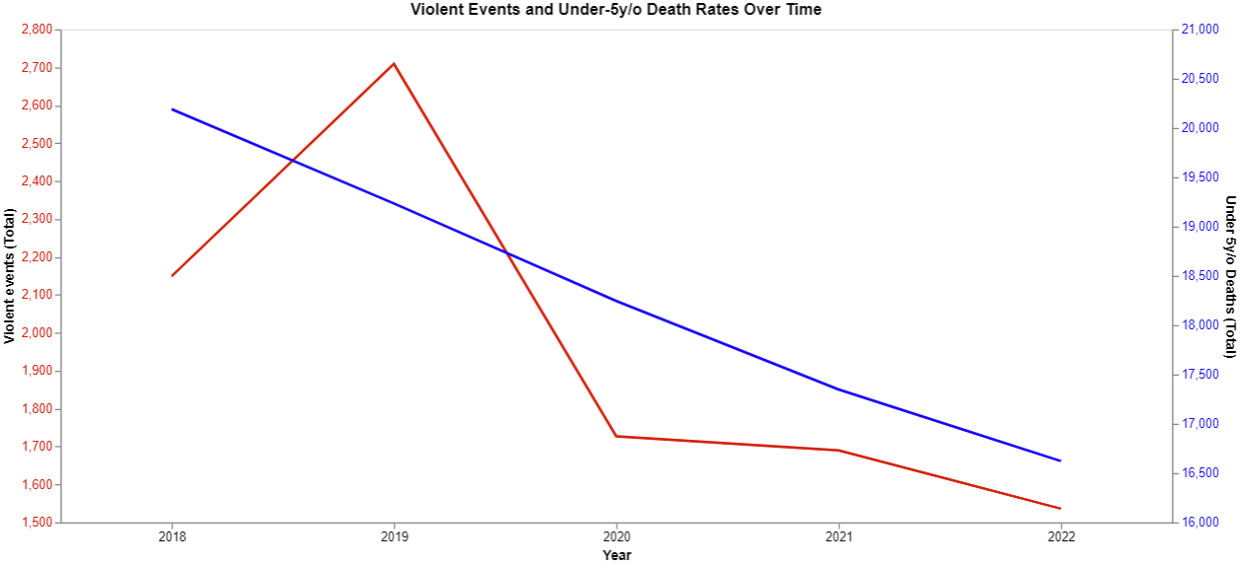
Under 5-year-old deaths steadily decrease as violent events decrease over time

Slide 17
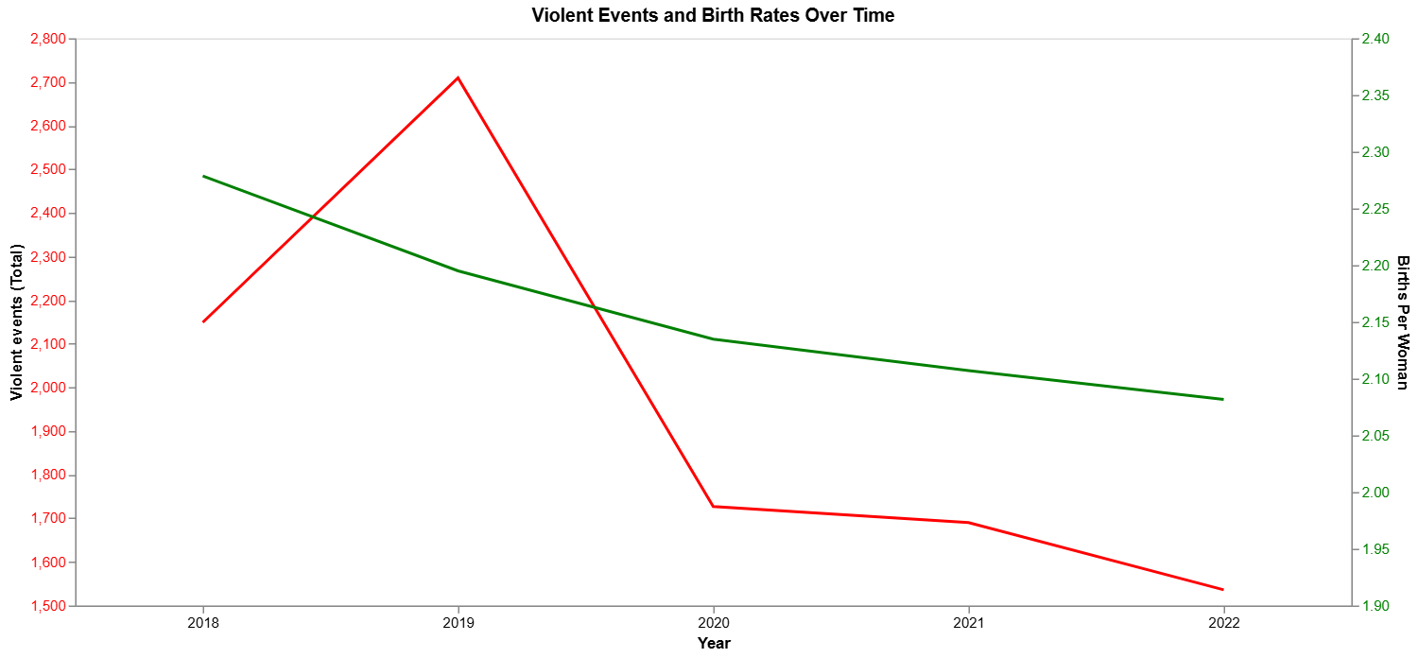
As violent events decrease, number of student enrollment tends to increase in the following year

Slide 18
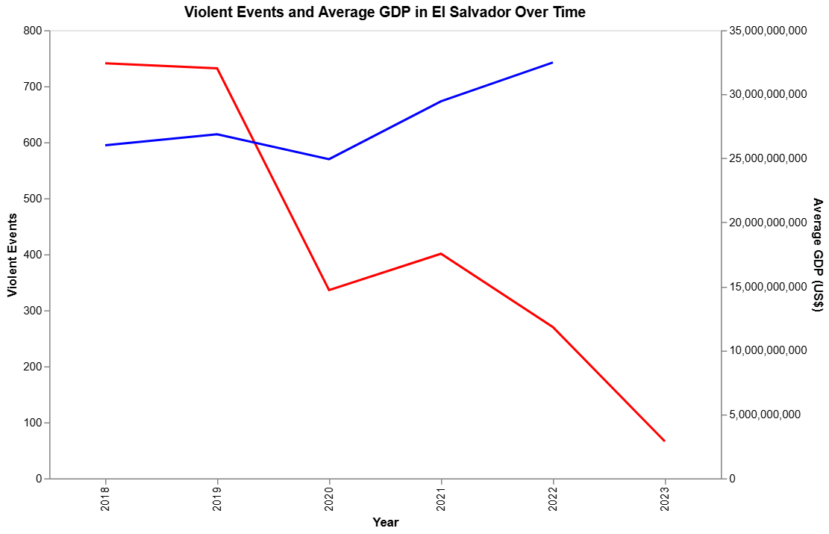
Violent events vs. average GDP in El Salvador over time

Slide 19
Conclusion
Violent Crime in El Salvador
On average, monthly attacks have drastically decreased in Central America from January 2018 to March 2024
El Salvador’s decrease in crime comes from four major shocks, including gang violence policies and the COVID pandemic
While many countries faced similar changes in crime, El Salvador’s violence reduction policies sharply diminished attacks
El Salvador reduced violent crime across the country, but increased it in rural areas near the Guatemala-Honduras border
Gang-related descriptions of attacks have steadily decreased while police-related descriptions slightly increased
Relationship Between Violent Crime and Economic Development
Expected monthly attacks have decreased in Central America, mostly due to vast reductions by El Salvador
Generally, decreases in the number of violent events are associated with increases in lagged school enrollment
As violent events decrease, generally GDP Per-capita increases

Slide 20
Appendix

Slide 21
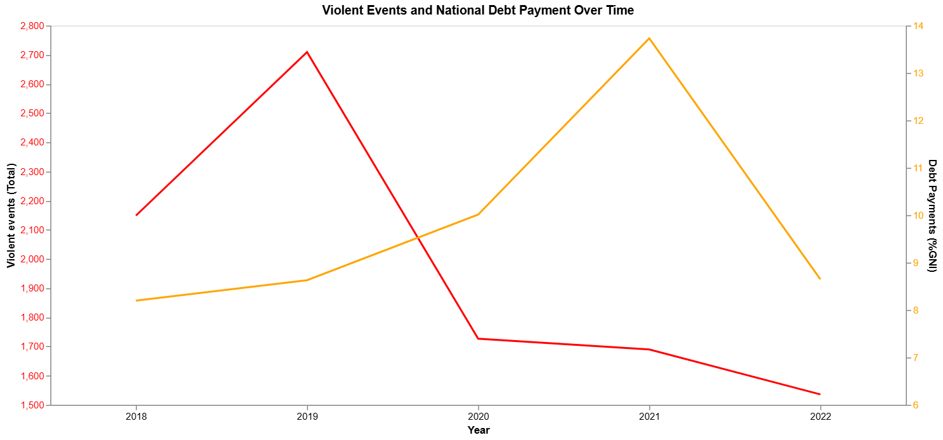
Generally, decreases in the number of violent events are associated with increases in debt payments

Slide 22
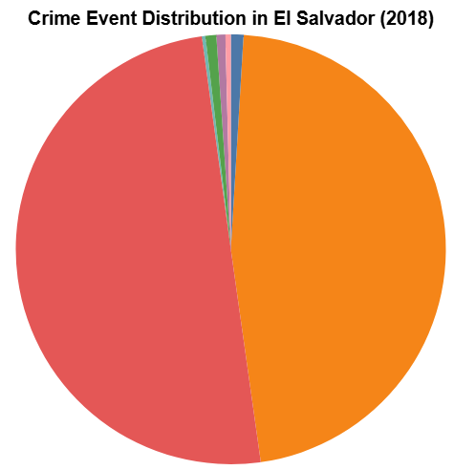
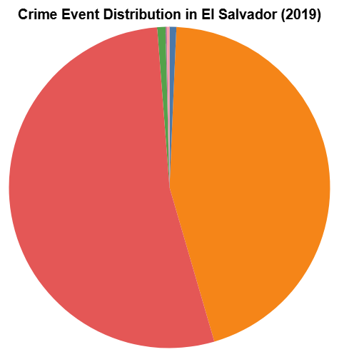
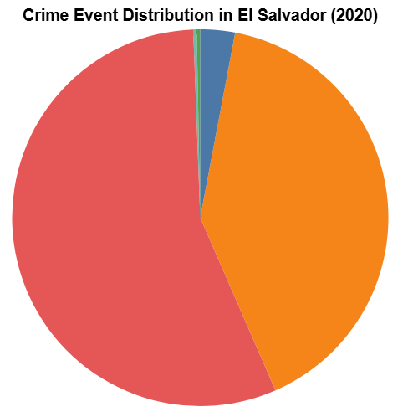
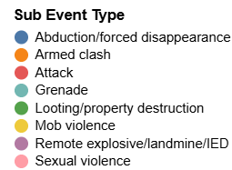
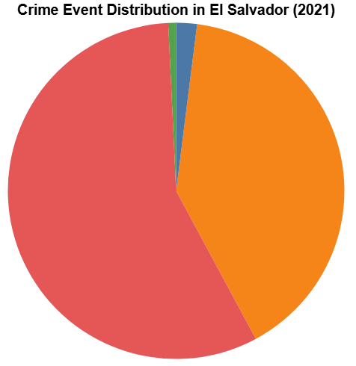
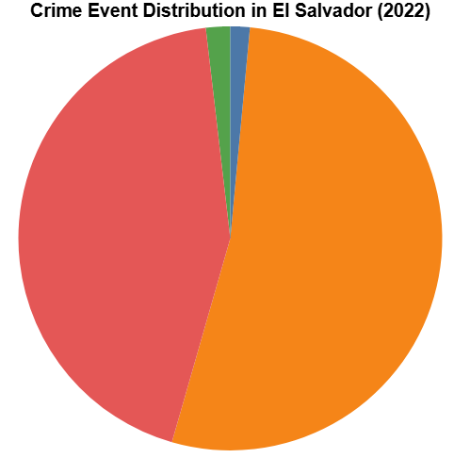
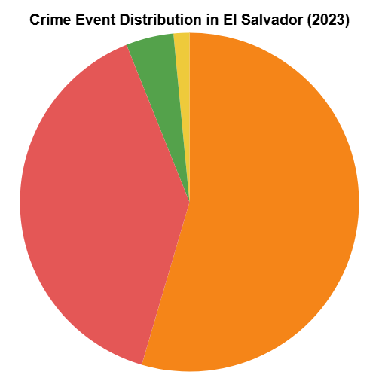
Civilian attacks steadily increased as a proportion of crime until 2020, reversed in 2021, and sharply decreased in 2022

Slide 23
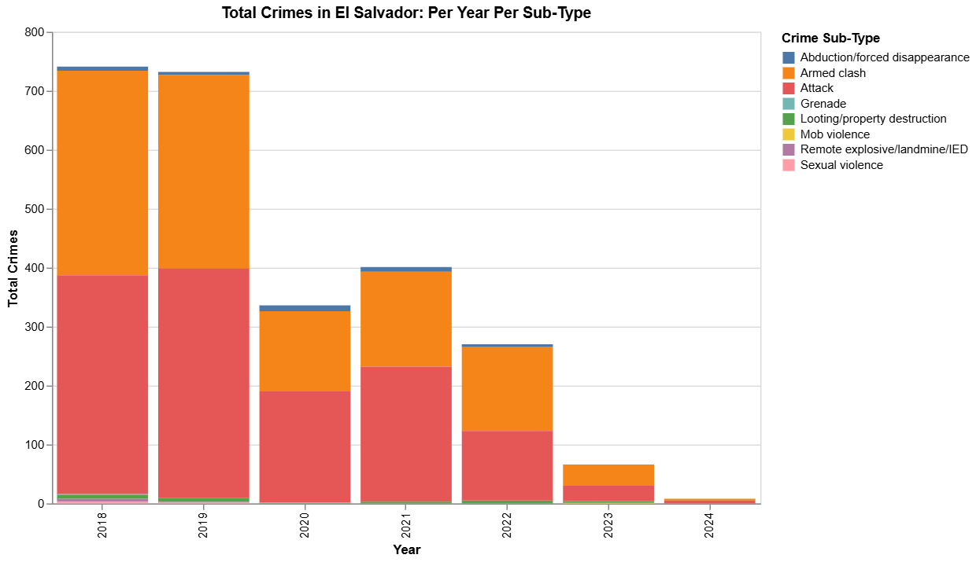
Civilians are facing less attacks, while organized criminal groups are engaging in less armed clashes

Slide 24
Violent events vs. birth rates over time

Slide 25
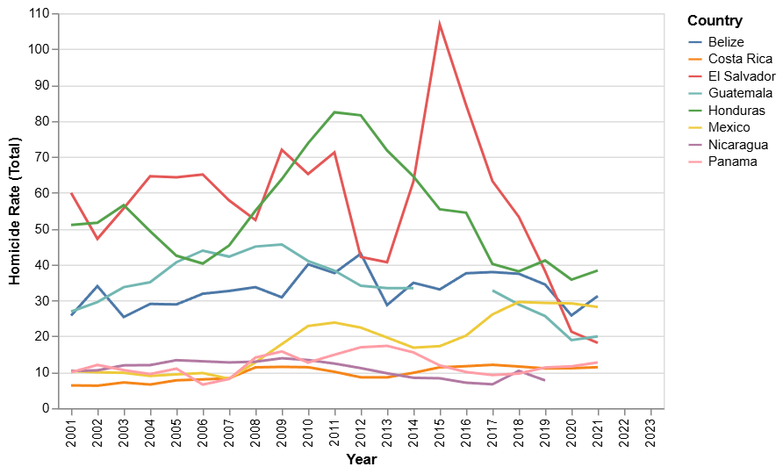
Central American country homicide rates across time (WB data)

Slide 26
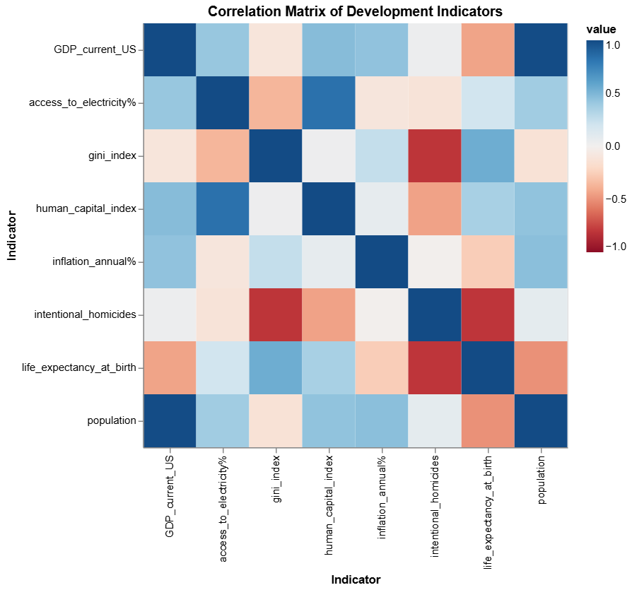
Correlation matrix of development indicators

Slide 27
Central American country homicide rates across time (WB data)

Slide 28
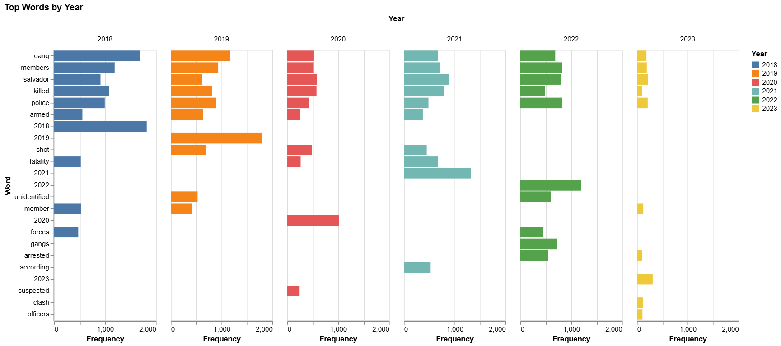
Gang-related descriptions of attacks in El Salvador have steadily decreased while police-related descriptions slightly increased

Slide 29
QUESTIONS?

